Slide 1
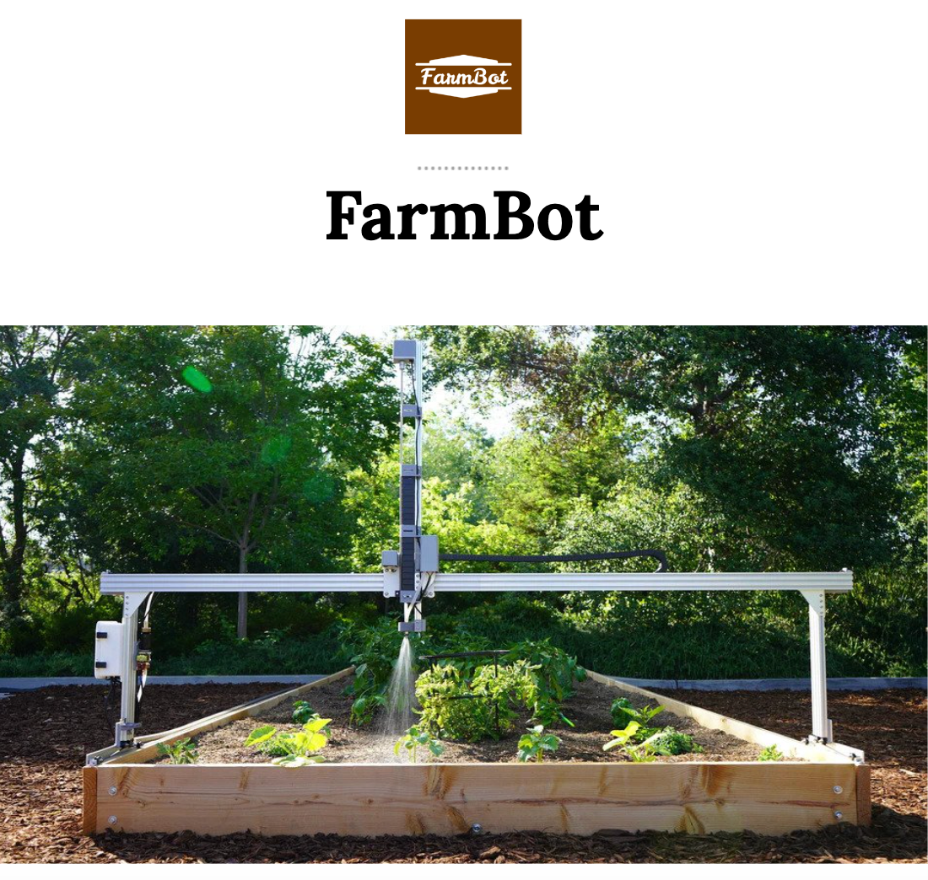
COMP90082 FA Wombat Final Presentation
Presenter:
Steve Zhang
Naixin Xu
Yinkai Chai
Notes:
Dear viewers, welcome to the final presentation of our FarmBot project by Team Wombat…….

Slide 2
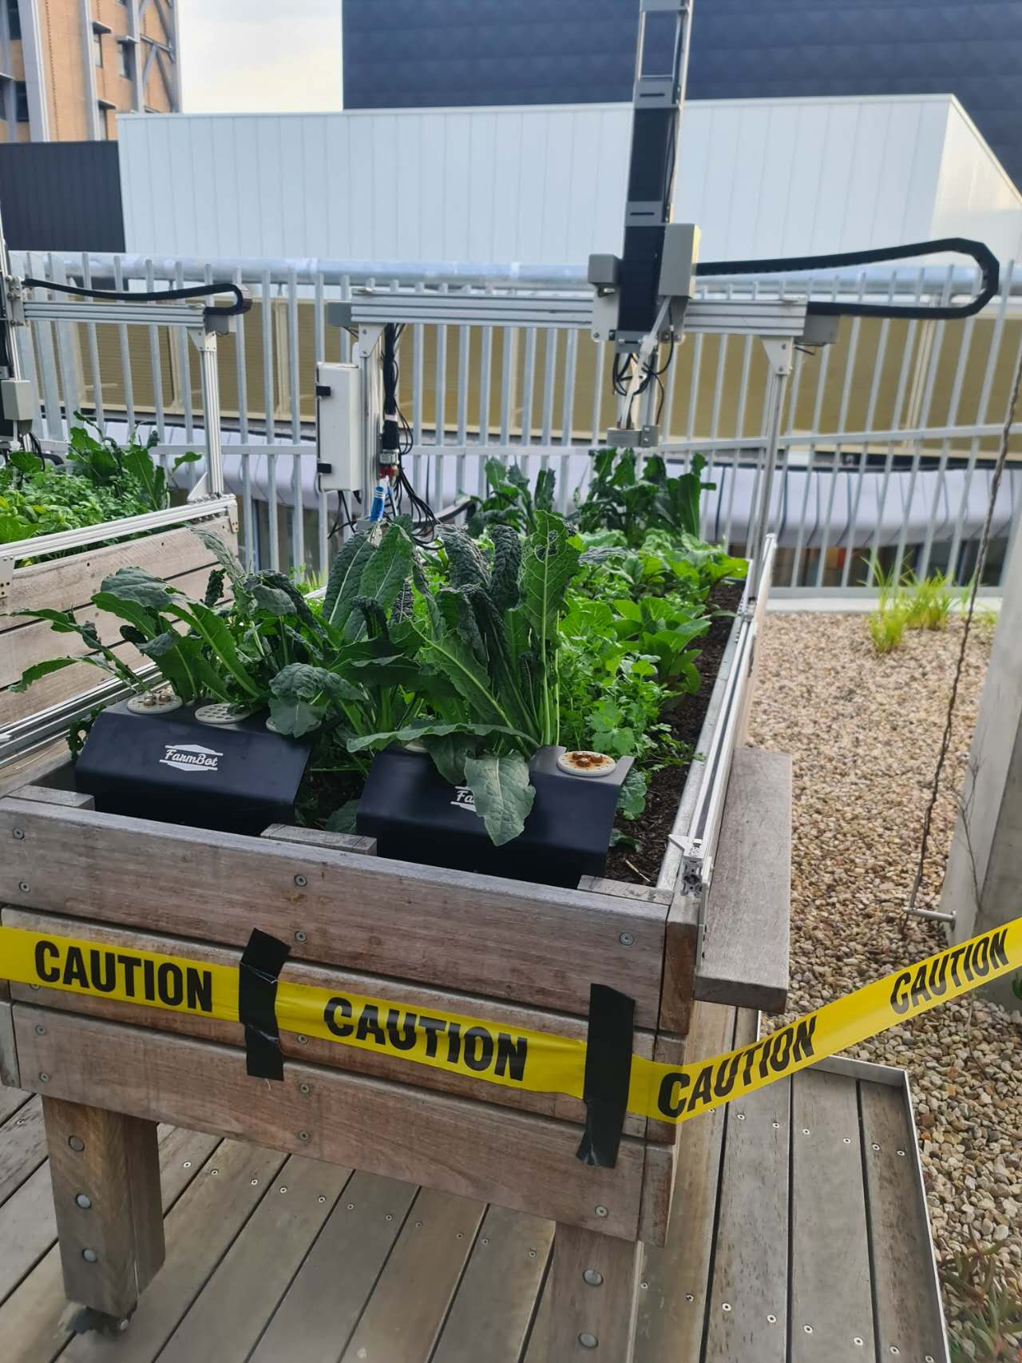
Context
About FarmBot
FarmBot introduction
Agricultural technology project launched in 2011
Precise tasks such as sowing, weeding and watering with robotics
Completely open source and can be further developed to support research
FarmBot Research Support
Help researchers explore different growing conditions
Optimize planting strategy
Improve research efficiency

Slide 3
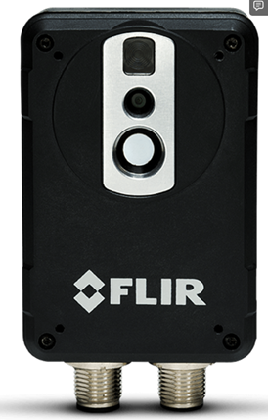
Context
About FLIR AX8
FLIR AX8 device introduction
Integrated camera and thermal imaging hardware
Compact and easy to install
Technical advantages of FLIR AX8
Complies with Ethernet/IP and Modbus TCP communication protocol standards
Results can be shared to programmable chips

Slide 4
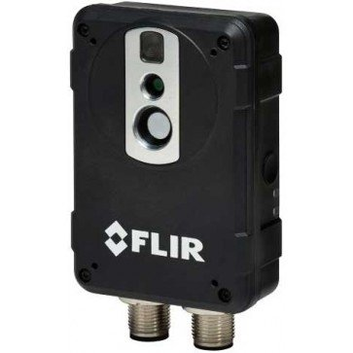
Objectives
Hardware:
Cable connections
Power Supply for equipments
Mounting Device
Software:
Transfer, integrate, and explore camera data
Design self-host webapp
Deploy and maintain all services to the public network

Slide 5
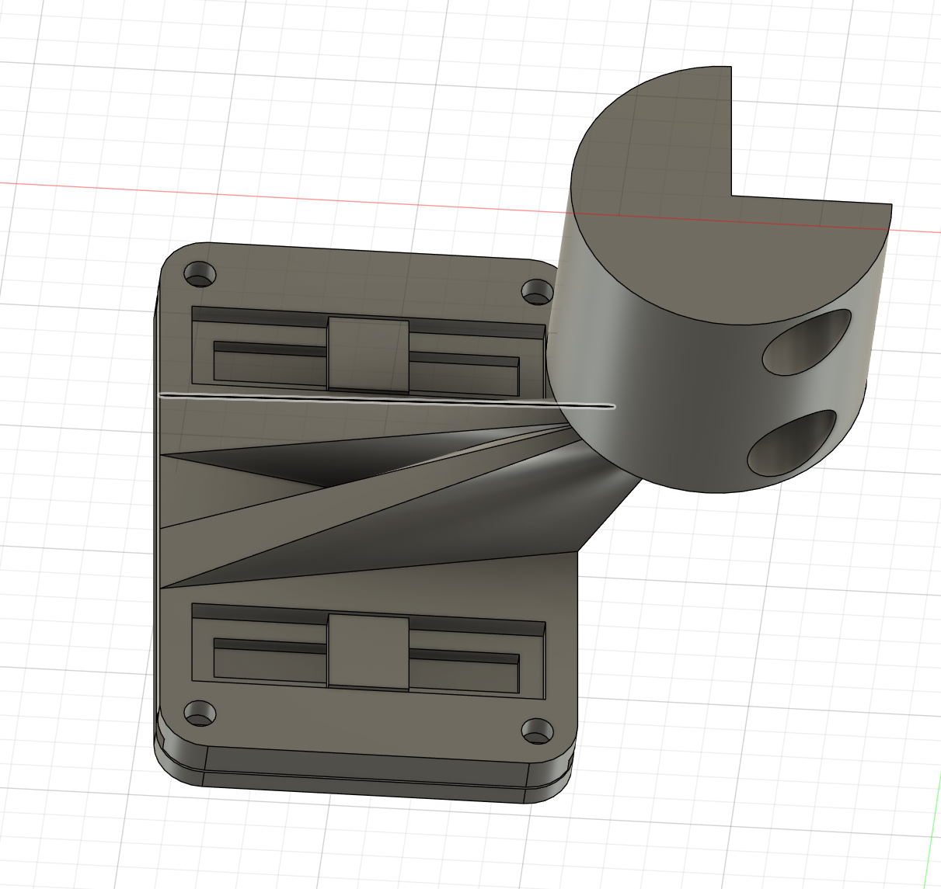
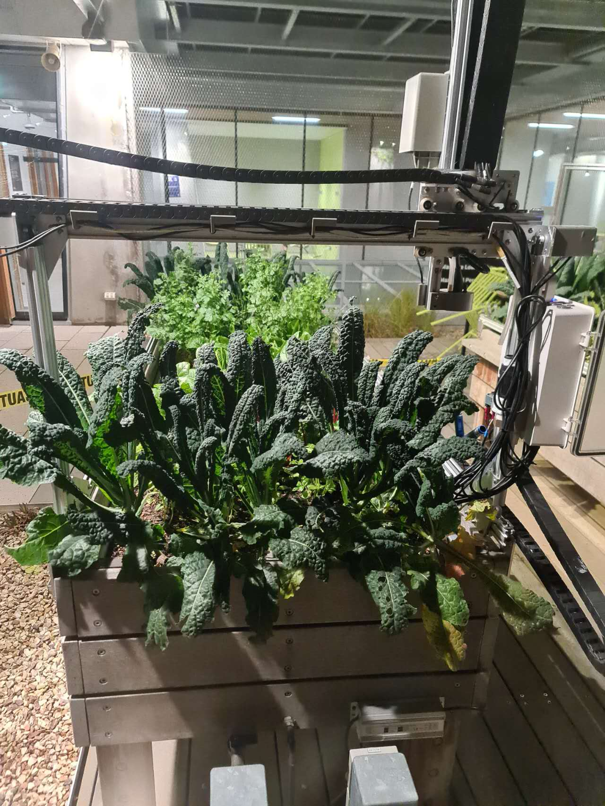
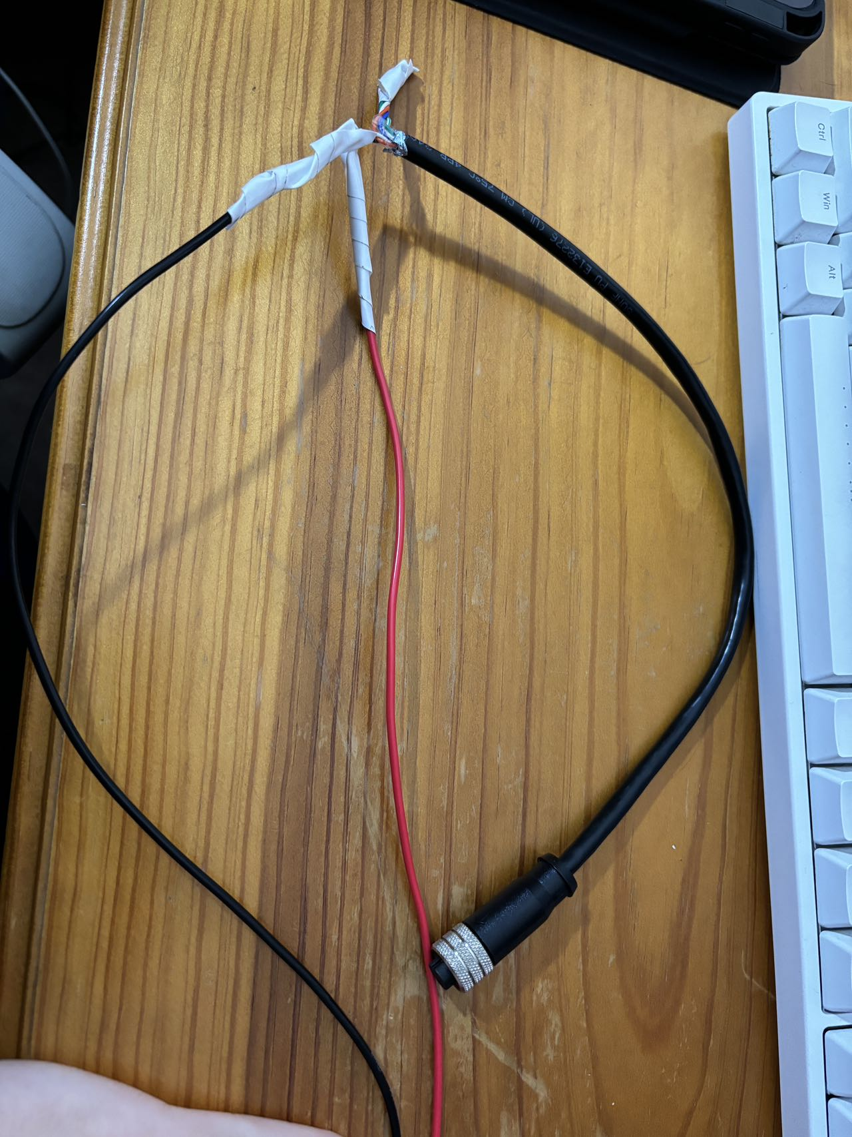
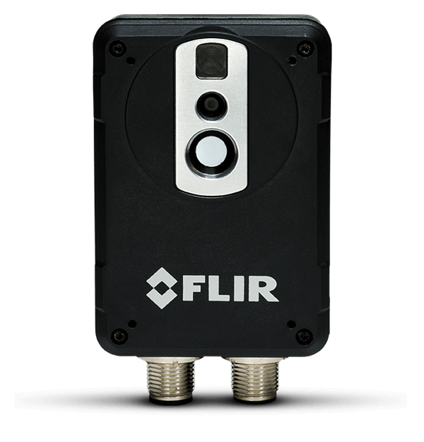
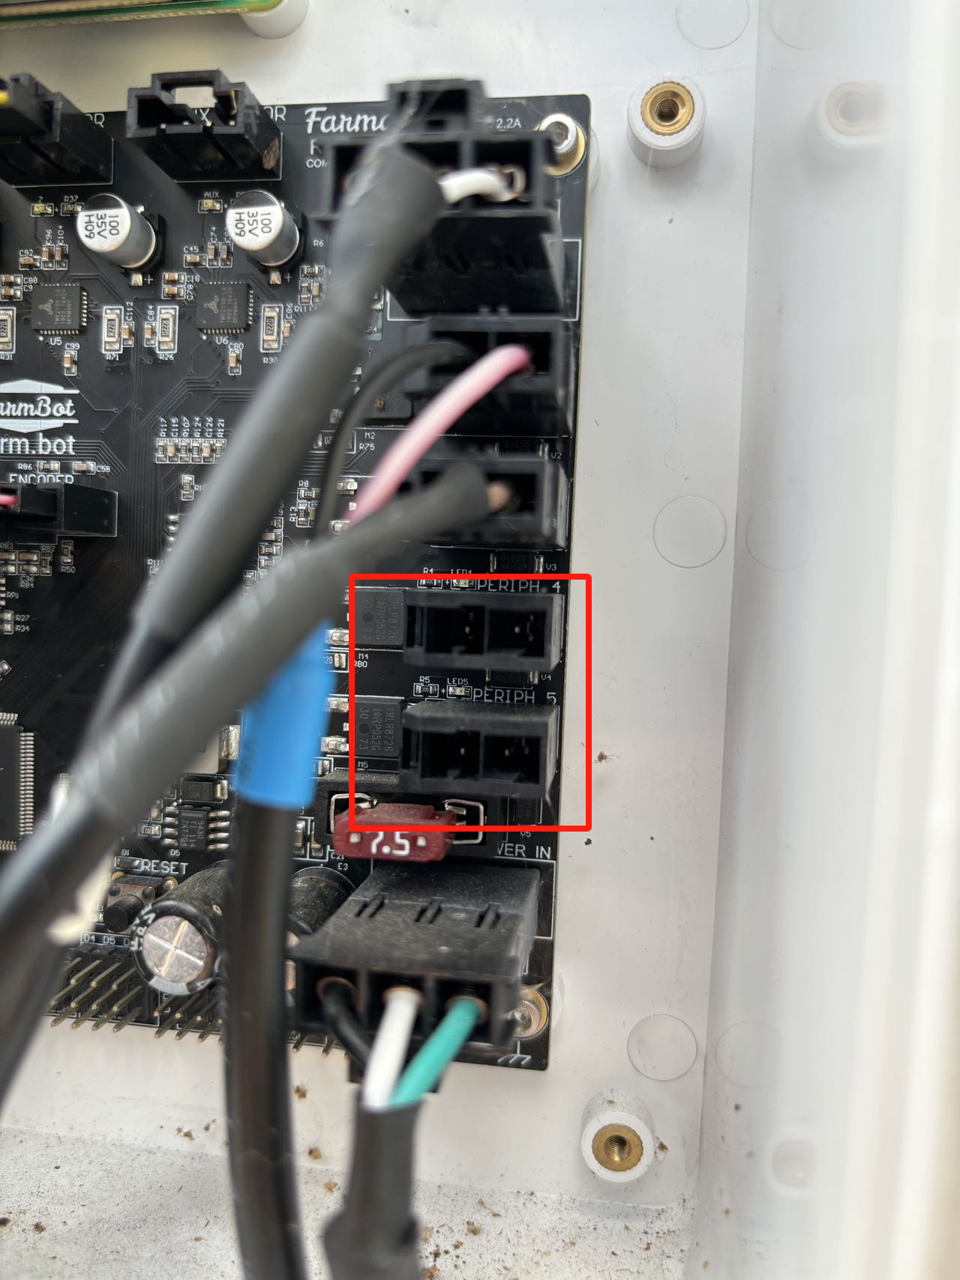
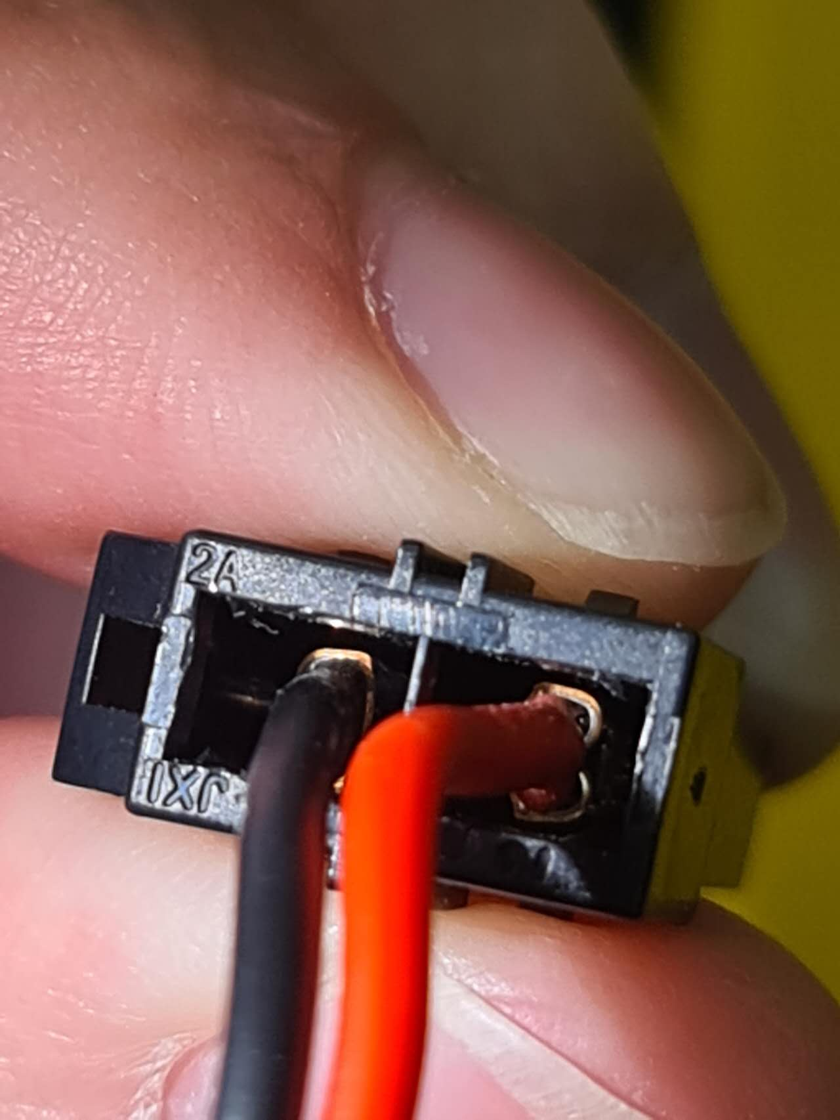
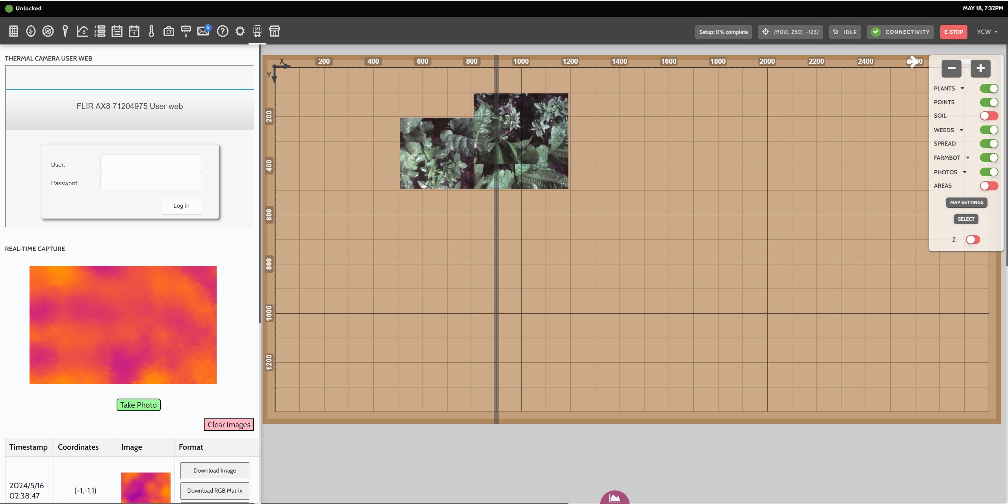

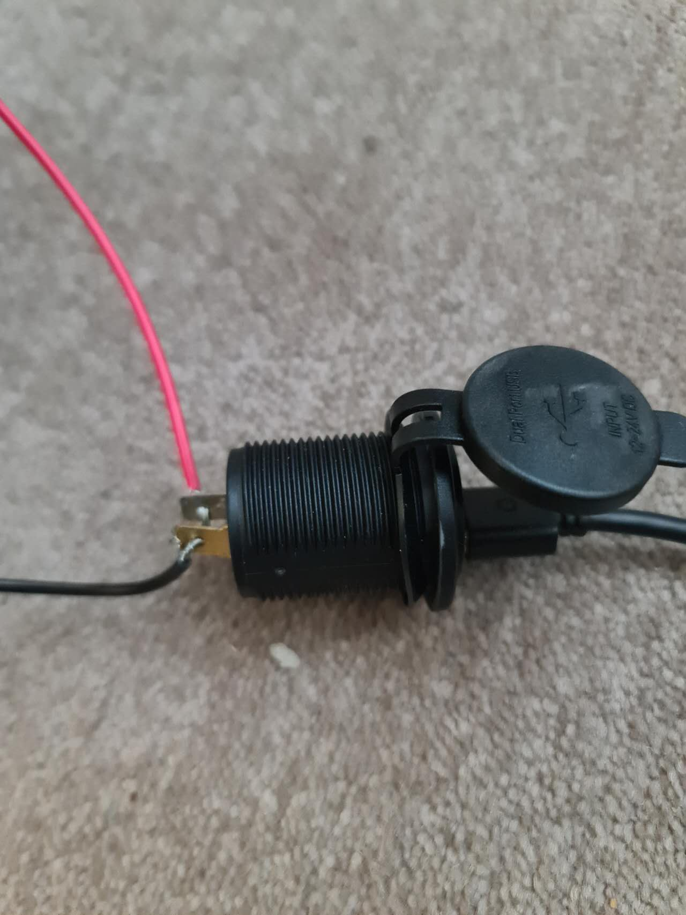
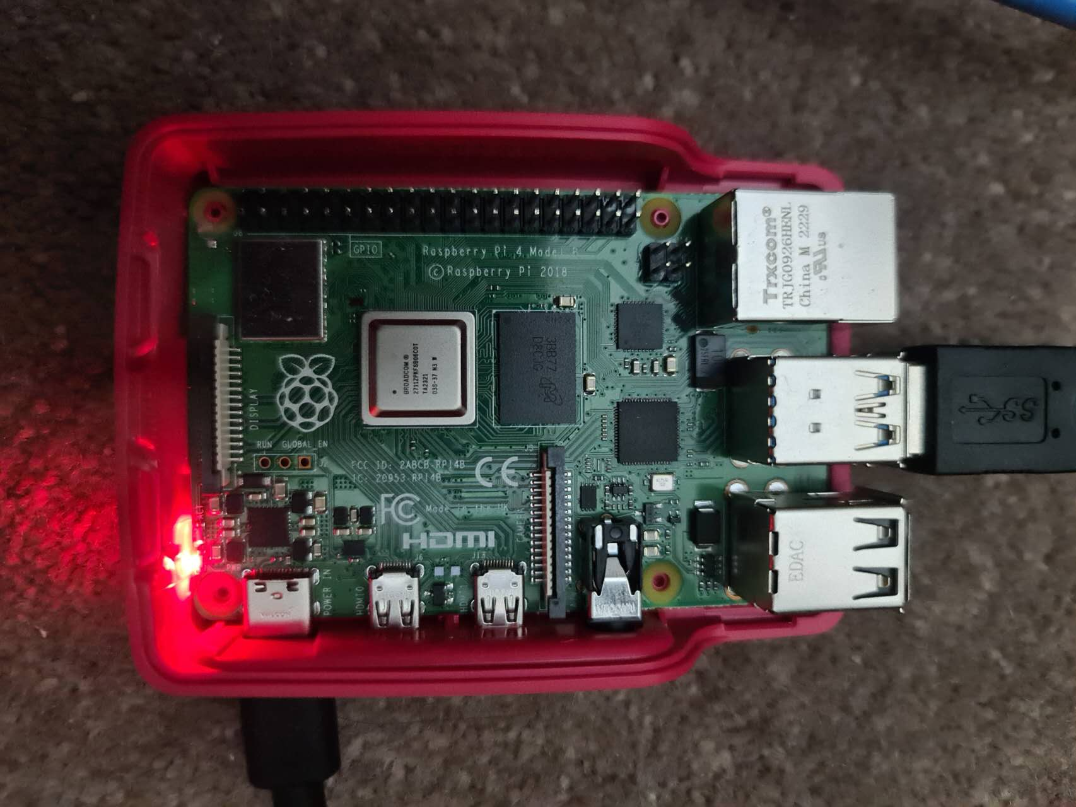
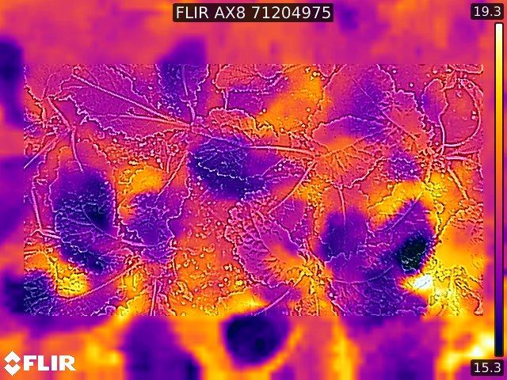


Design Architecture
*Animations included
Hardware
Offline Farmbot
Mount device
Setup through WIFI
AX8 Camera
Using DHCP to access camera’s API
Self-host Webapp
24V Power Output
Cloud server
Direct access
24V to 5V usb adpter
Software
FRP
Raspberry pi
Public camera access
Notes:
So right now, I am going to draw our design architecture. We start everything from powering up our hardware. Since the FarmBot is primarily used outdoors, all equipment should ideally be placed in the FarmBot's electronics box along with the motherboard. We use the two spare 24V power outputs on the motherboard for power supply.
To power the AX8 thermal camera, we soldered cables and connected them to the appropriate connector housing. On the other hand, due to the lack of documentation support for FarmBot OS, our team adopted a second Raspberry Pi as an intermediary platform for communication between the FarmBot and the camera. In reality, there is no direct data exchange between the camera and the FarmBot. The Pi operates at a rated voltage of 5V, so we additionally used a 24V to 5V USB adapter for power supply.
On the Pi, we assigned the camera an internal network address using DHCP, which gives us access to the camera's API and internal services. However, to allow the FarmBot and its web app to use the camera data, we had to set up a server and assign it a public IP address. This way, as long as the machine is connected to the internet, it can directly retrieve the camera data.
Achieving this step was quite tricky because we encountered many challenges and bugs during development. We ultimately used FRP, a high-performance application, which takes advantage of network penetration to present the camera's services and use reverse proxy to avoid issues caused by the same-origin policy.
After completing this step, we could finally start building our own FarmBot self-hosted web app and directly call the camera data within the web app. By using the cloud server, we successfully hosted the web app and connected it with the FarmBot in a WiFi environment. Additionally, we designed a mounting device to physically attach the camera to the FarmBot's mechanical arm.
Looking at the entire framework, we can classify the bottom right part as the software development, while the top left part is the hardware integration. It may seem a bit complex, but next, I will demonstrate some hardware and software demos to help you understand our work.

Slide 6
Hardware Overview
Hardware
Offline Farmbot
Mount device
AX8 Camera
24V Power Output
24V to 5V usb adpter
Raspberry pi
Notes:
First, we come to the hardware demo, this is our hardware overview.

Slide 7
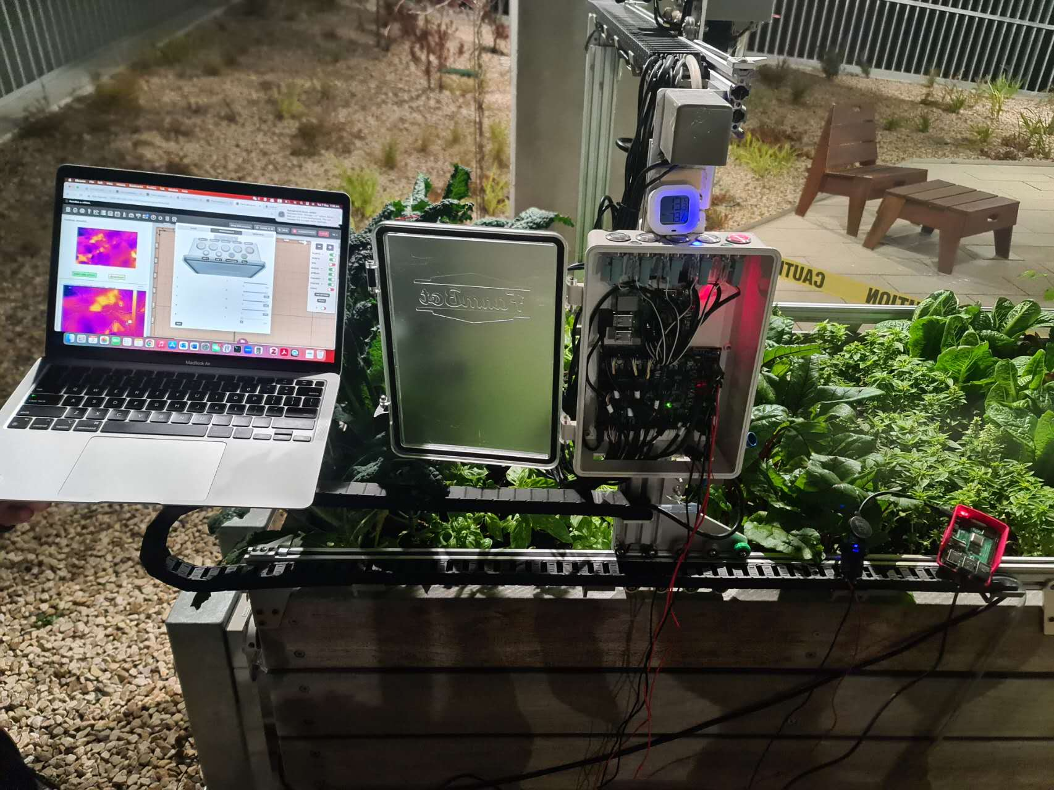
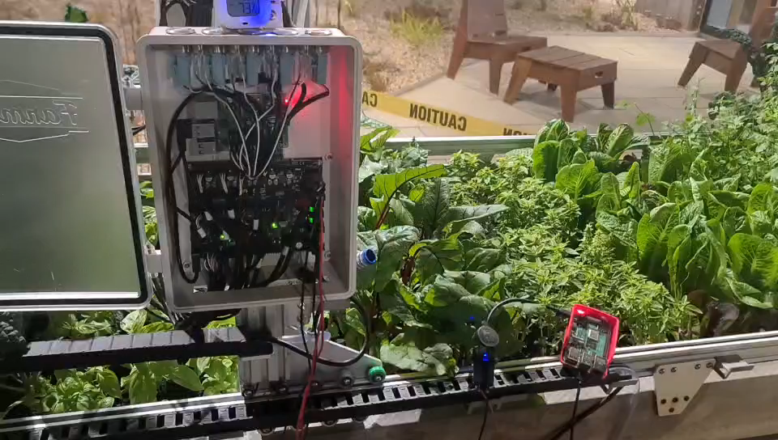
Hardware Demo – Offline Deployment
*Animations included
Notes:
In the first half of the semester, we focused on achieving cable connections and power supply. This segment of the video shows how we connected the various cables and supplied power to the Raspberry Pi and thermal camera in our final offline deployment.
And this is the final picture.

Slide 8
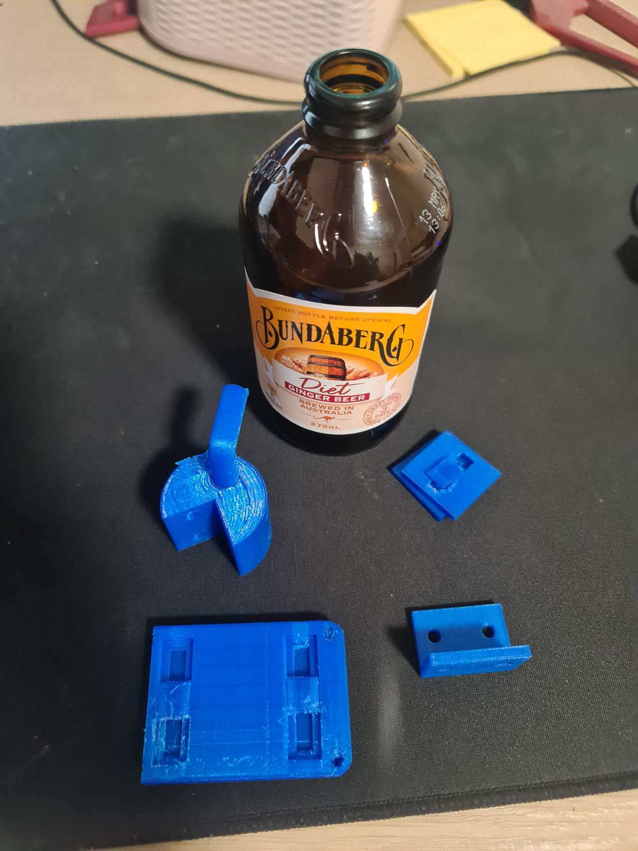
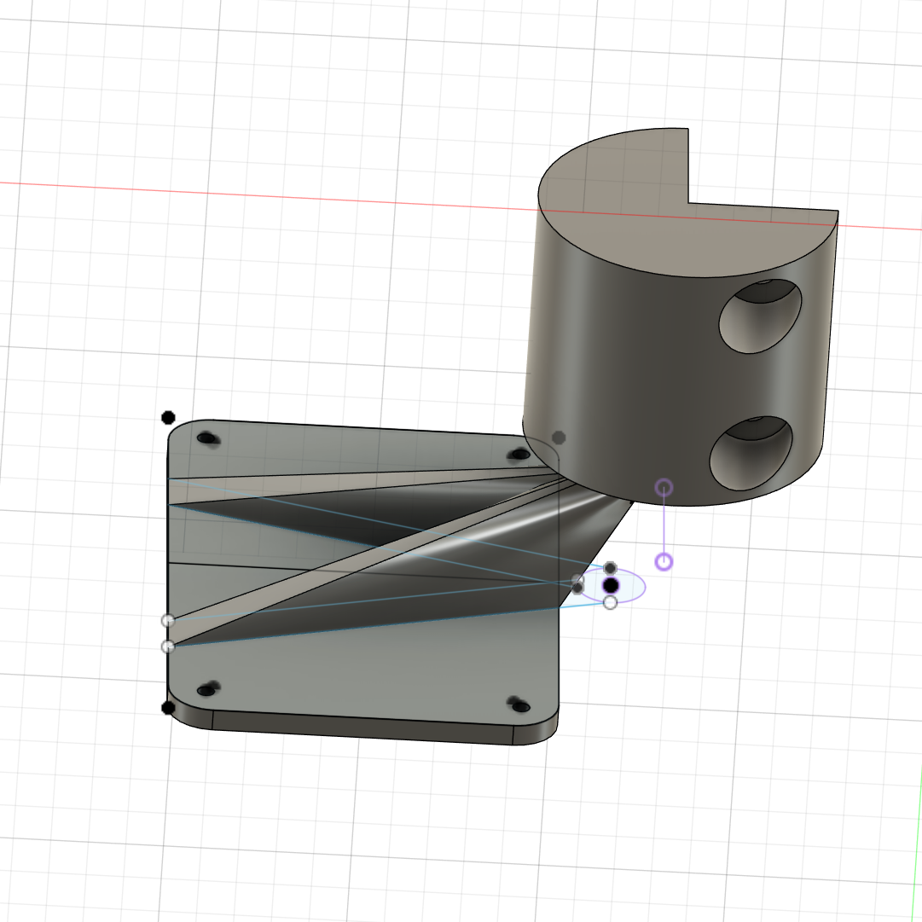
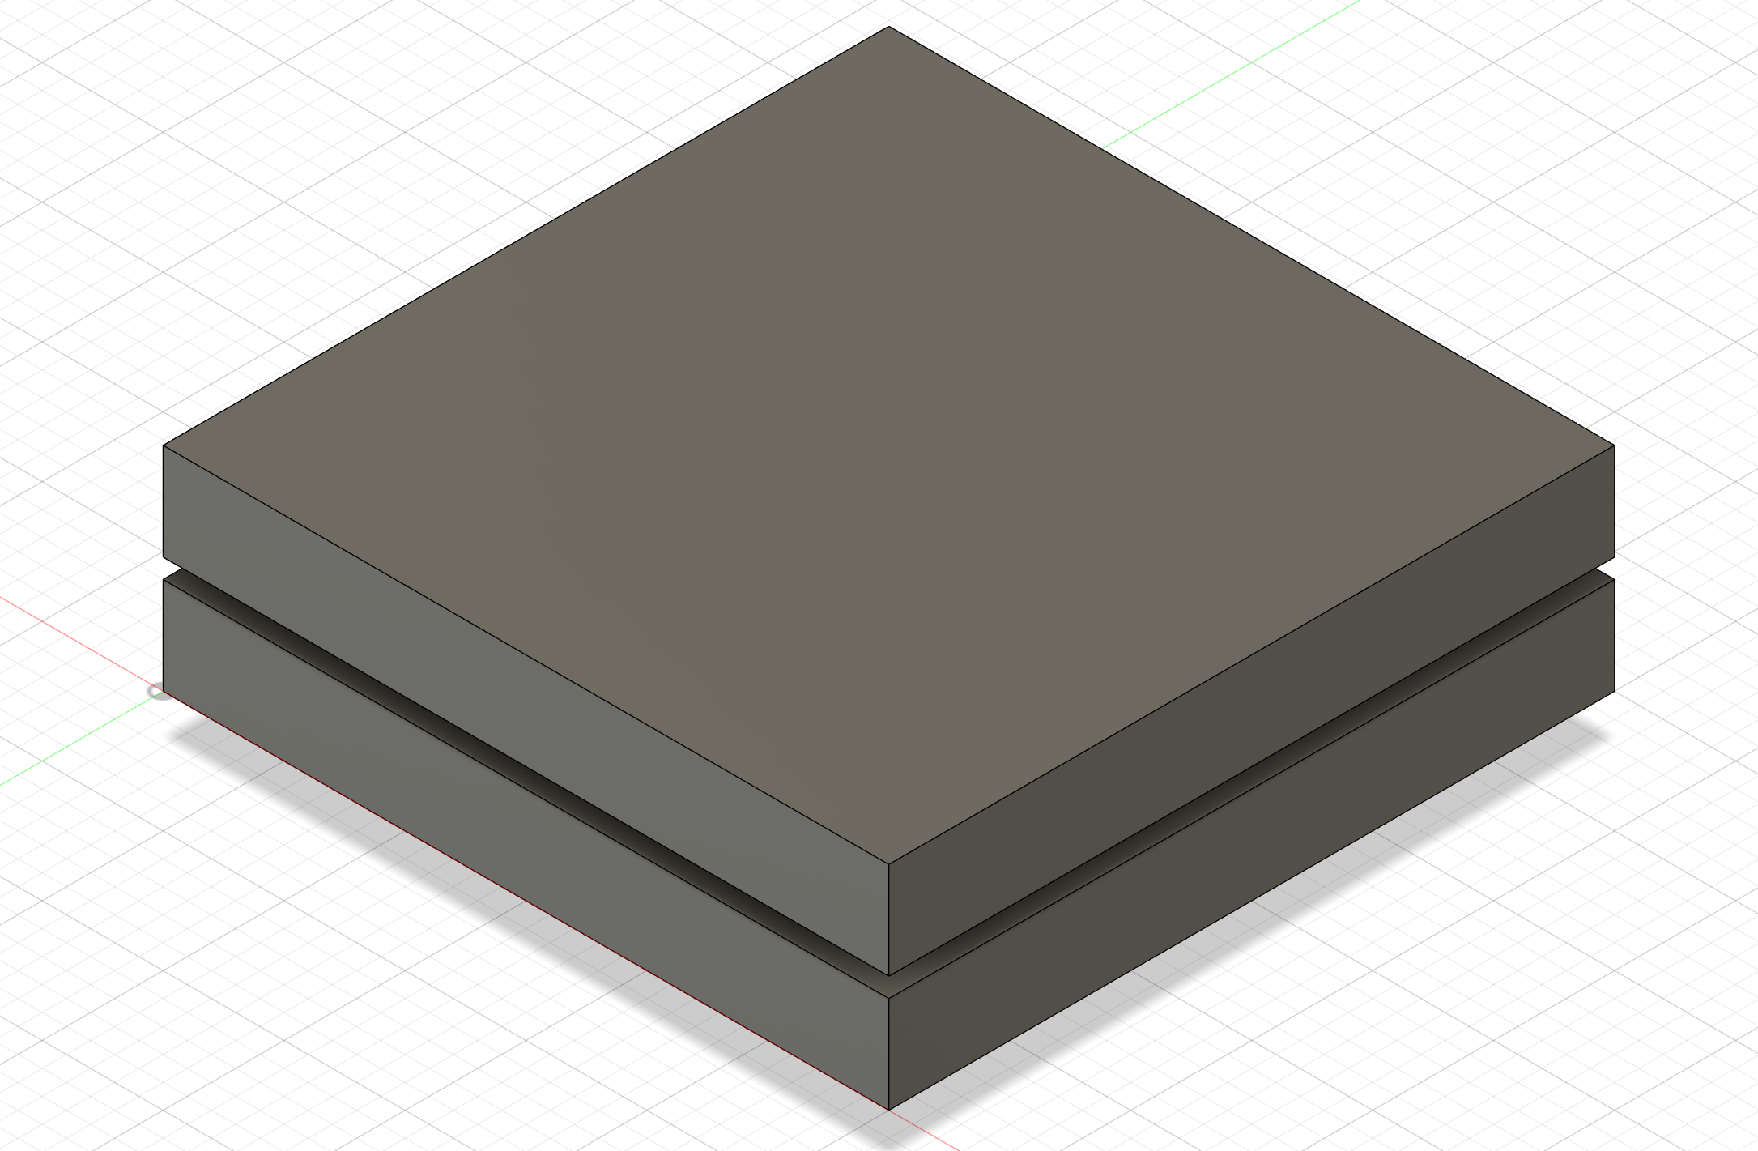
Hardware Demo – Mounting Device 1
*Animations included
Notes:
Coming to the end of the semester, our focus shifted to the mounting device. Previously, we had a mounting device designed by the previous team, but after offline testing, we found that its size and design did not meet the installation requirements. Therefore, we decided to redesign the 3D model using CAD software, and manufacture our final device with 3D printing. Of course, before the actual deployment, multiple prototypes were printed to ensure functionality.

Slide 9
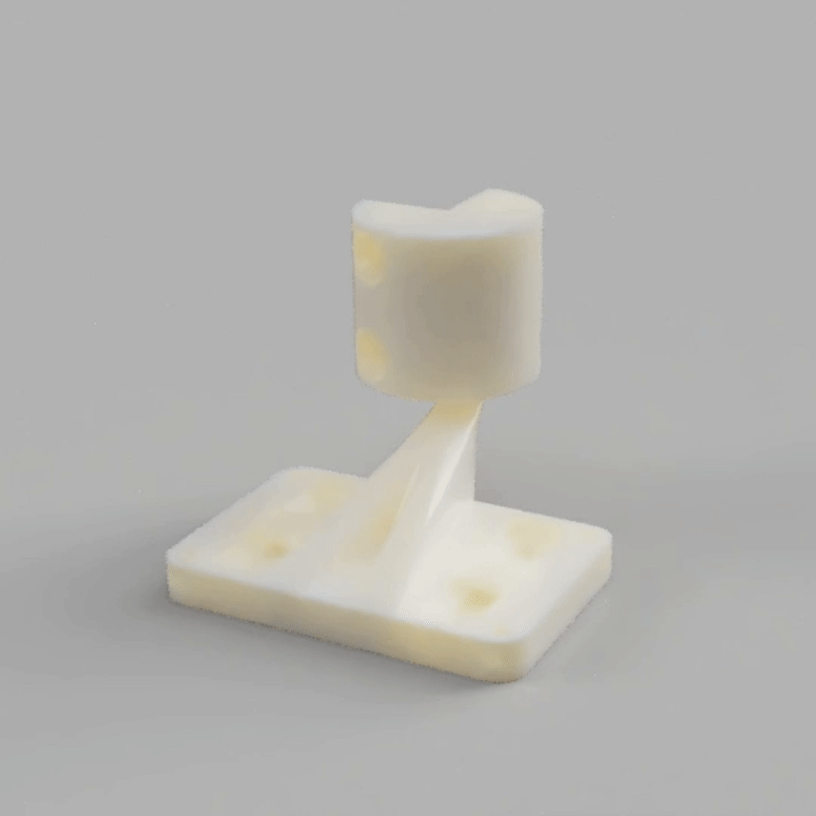
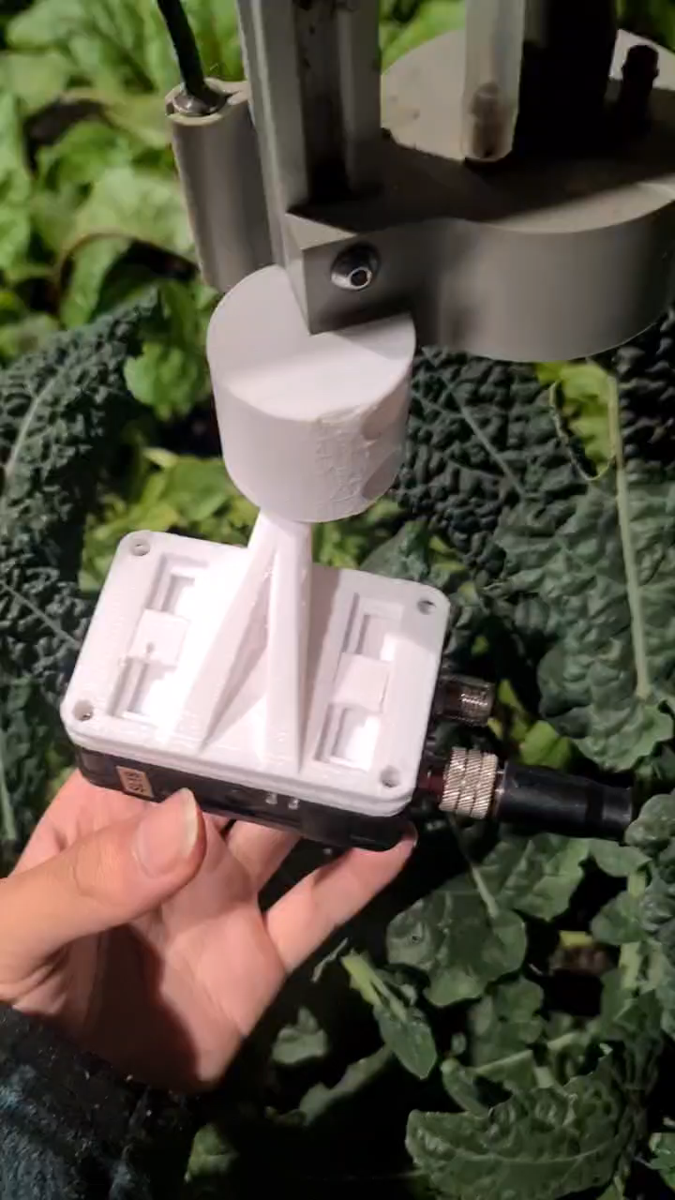
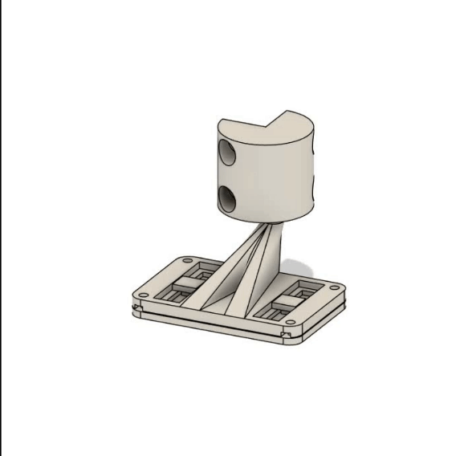
Hardware Demo – Mounting Device 2
Notes:
These clips show the design of our final mounting device and how it operates on the FarmBot machine. Our mounting device has a high degree of freedom; it can rotate and move horizontally. Additionally, it is worth mentioning that this device is printed as a single part, requiring no screws or connectors between the internal components, making it very easy to 3D print and assemble.
(We only need to install two screws to secure it to the end of the Farmbot mechanical arm.)

Slide 10
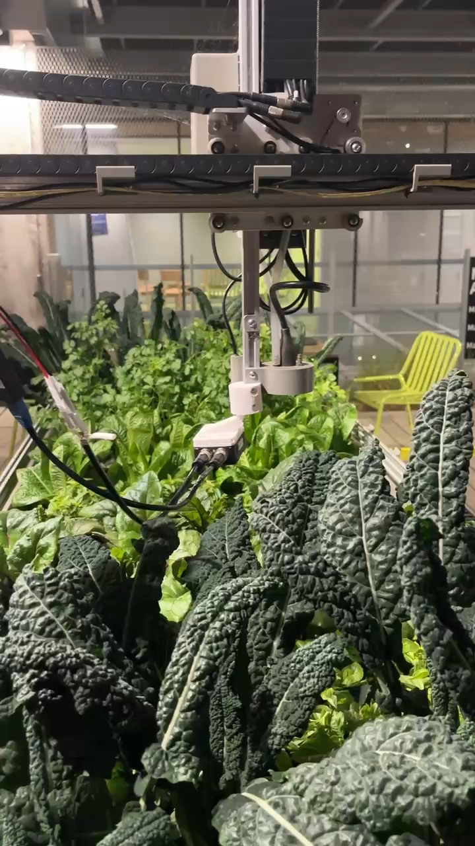
Hardware Demo - Mounting Device 3
Notes:
This video segment demonstrates how our camera moves in sync with the Farmbot arm.

Slide 11


Software Overview
Software
Offline Farmbot
Self-host Webapp
Setup through WIFI
Python Microservices
AX8 Camera
Apply Functions
Using DHCP to access camera’s API
Cloud server
Direct access
Local Database
iframe
Raspberry pi
Public camera access
Notes:
Now coming to our software section, there are two key points I want to share. First, we used Python microservices in our self-hosted web app to implement simple functions like image conversion and potentially some basic AI recognition features. Additionally, we deployed a local database using IndexedDB to store thermal images.

Slide 12
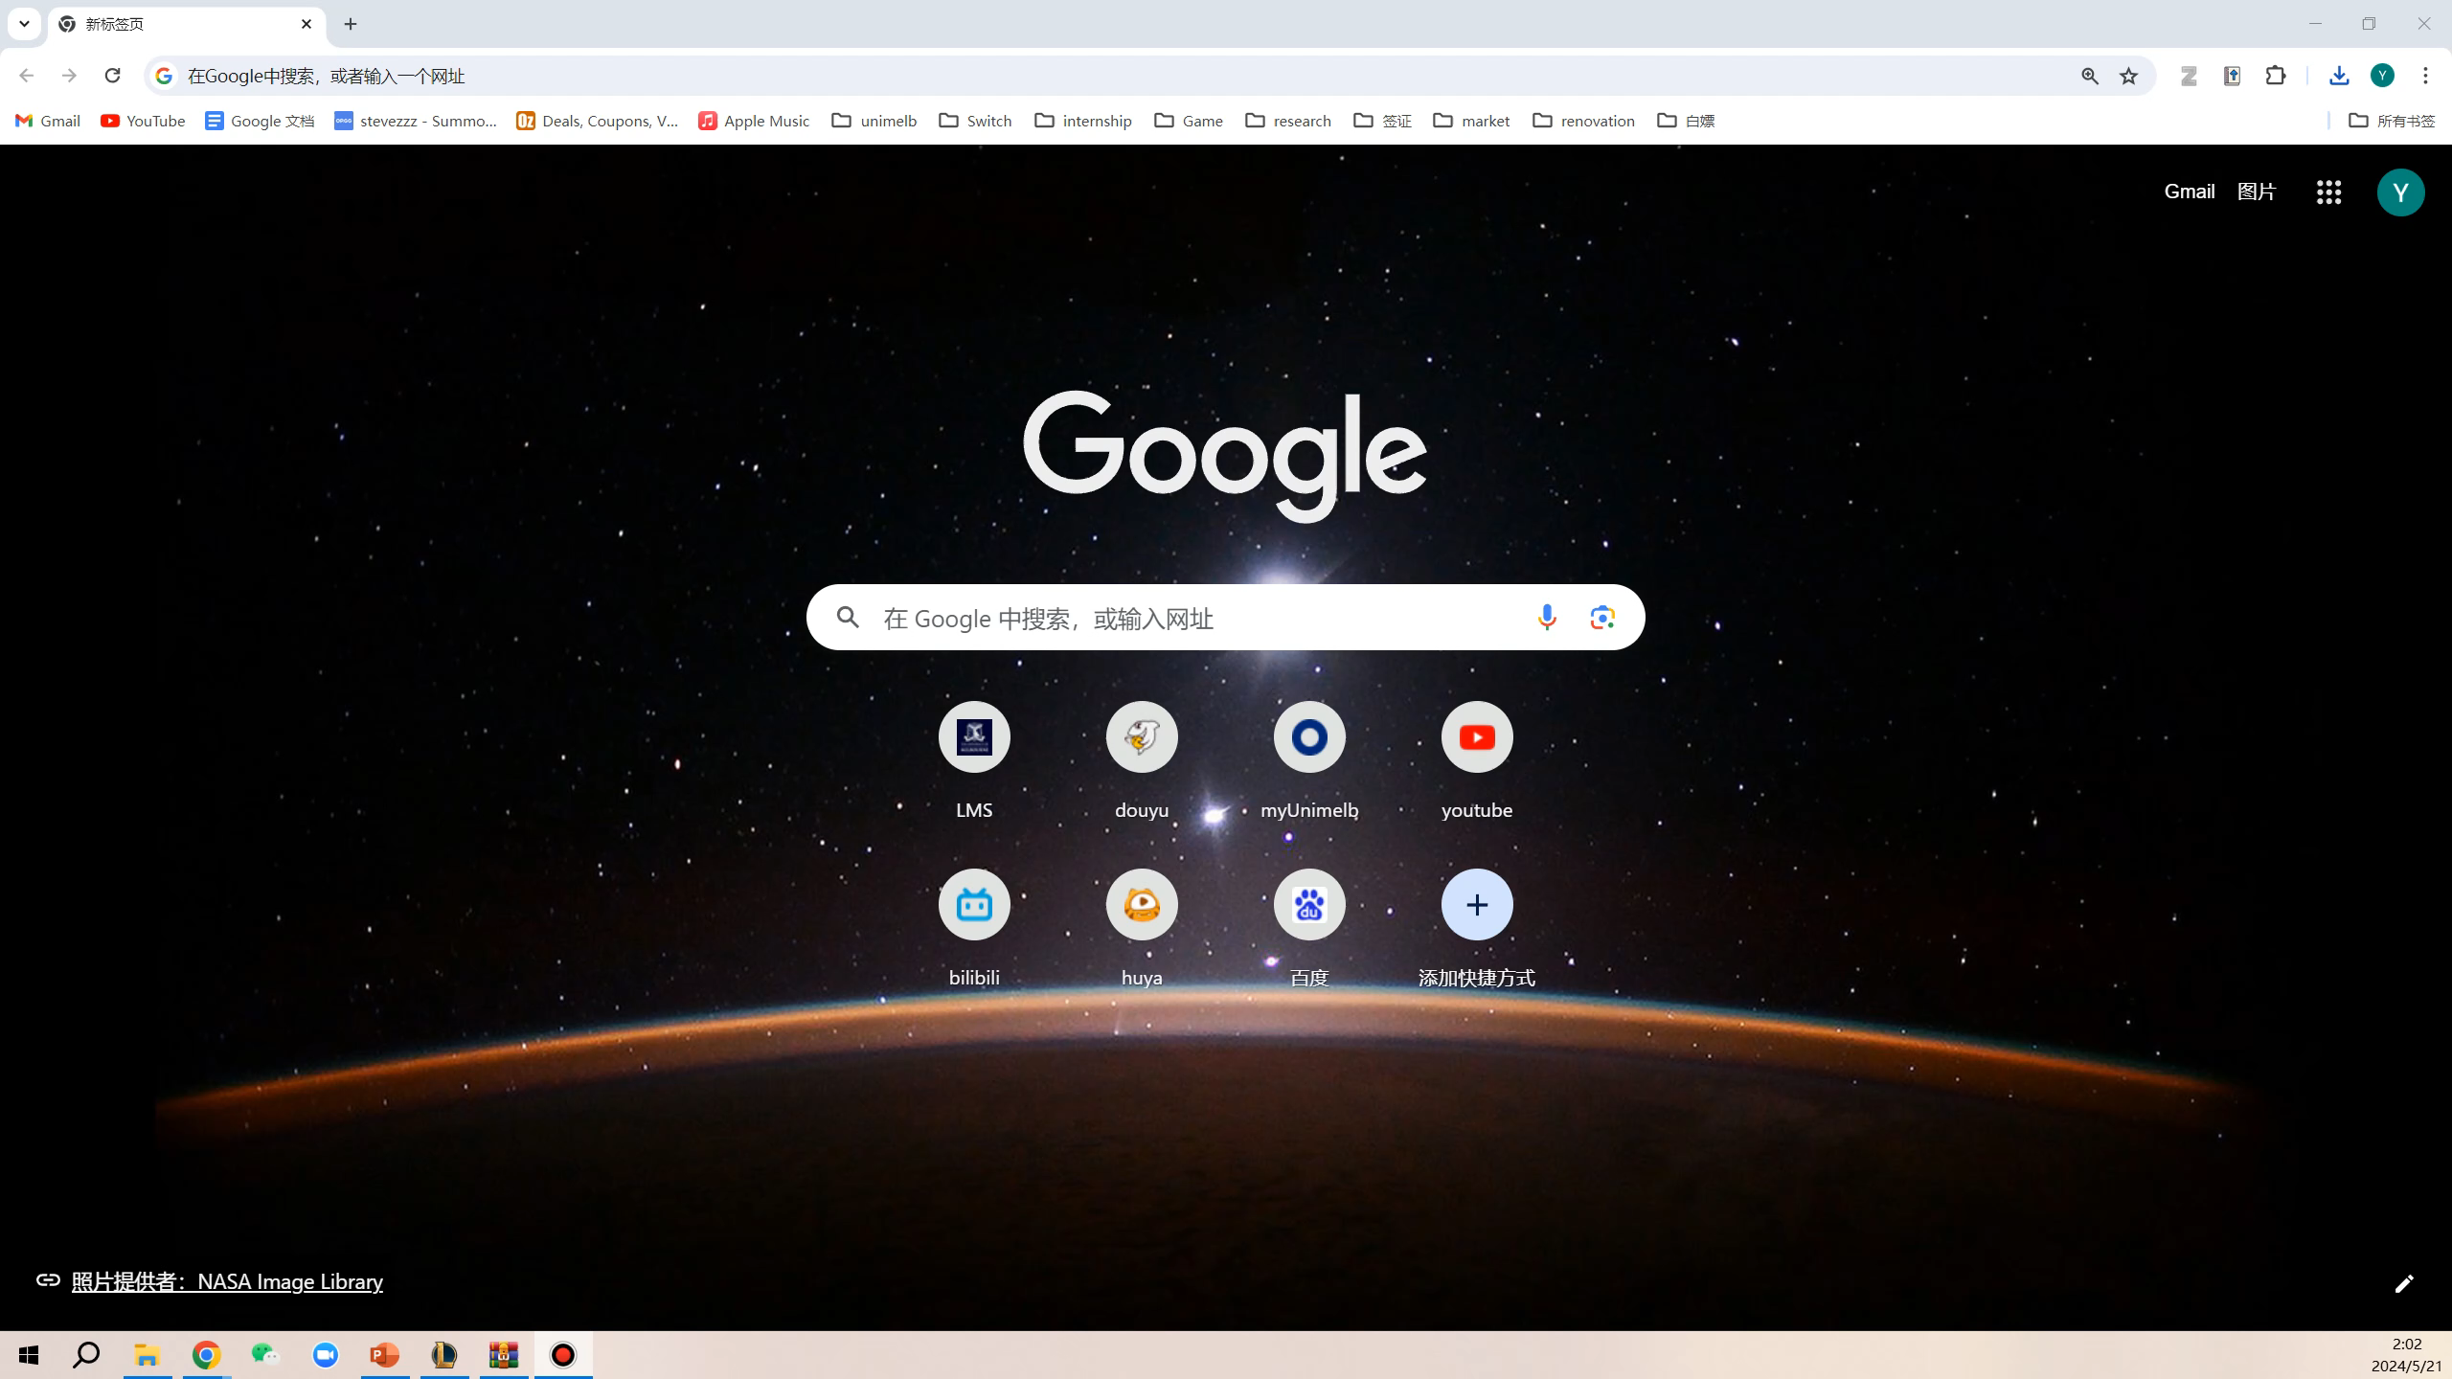
Software Demo – Webapp Showcase 1
Notes:
This segment of the video demonstrates how we access our web app through our browser. It is deployed to a public IP. After entering the username and password, we access the main page. The connectivity of FarmBot is fully set up. At the top, we have added another tab for displaying thermal camera function. In this tab, we have integrated the camera API and its internal service so users can adjust the camera’s parameters. They can also check the historical pictures stored within the camera. When users click the 'take photo’ button, they can see the time and coordinates of the thermal image they take and download the thermal image in various formats, such as the original JPEG image, RGB matrix, or matrix in the frequency domain.

Slide 13
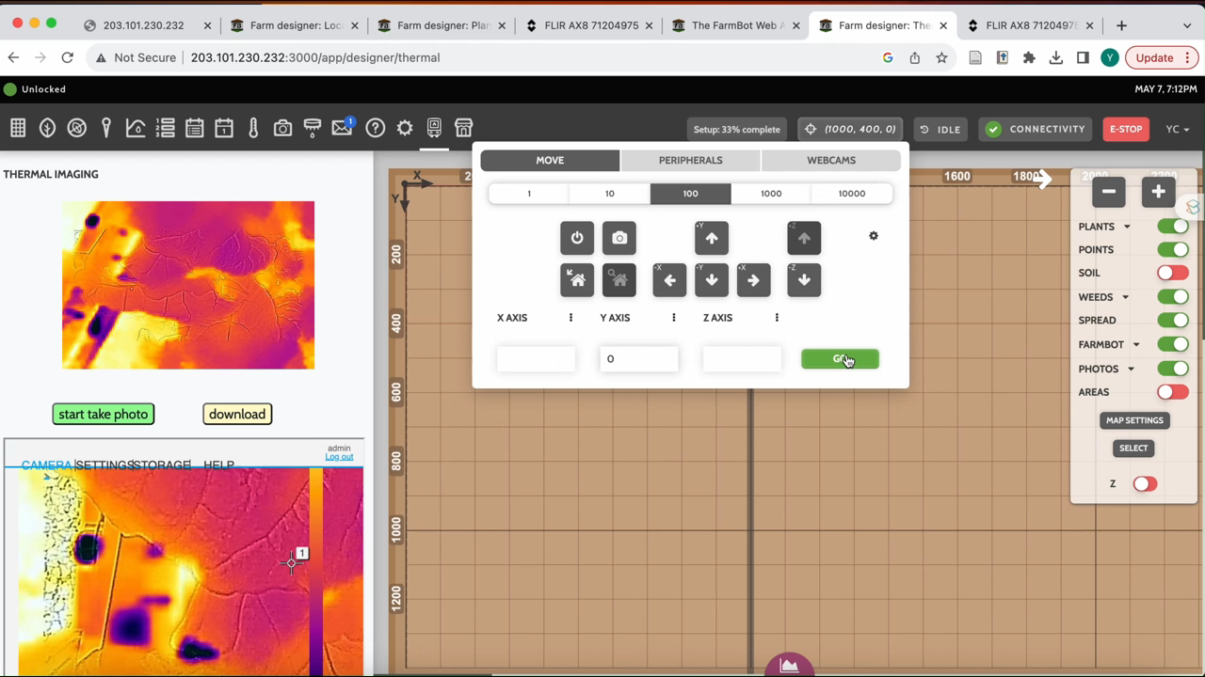
Software Demo – Webapp Showcase 2
Notes:
At last, we would like to show a segment of the video that demonstrates the moving thermal images while the FarmBot arm is in motion. To be mentioned, this UI design is still the old version.
So, this concludes our software section. We believe there is still a lot of room for improvement, but our team will stop at this point, and awaiting future improvements.

Slide 14
Challenge & Future Work
Challenges
Complex webapp code
Lack of development documentation
Debugging the FarmBot machine
Power supply issues
Future Plans
AI temperature recognition
Reducing energy consumption
Adding thermal imaging

